Slide 1
0209 汇报
总体调研情况-调研汇报-任务进展更新

Slide 2
1. 总体调研情况
来源-情况

Slide 3
调研情况
Source: Nature Portfolio (主要Nature 子刊)
Keyword：Graph；Graph Representation; Vectorization
NUM | TITLE | Time | Journal | IF | NOTE
1 | Amelioration of Alzheimer’s disease pathology by mitophagy inducers ... | 2022.1.6 | Nature Biomedical Engineering | 29.234 | Alzheimer’s disease pathology 涉及vector representations of molecular structures
2 | Graph Representation Learning in Biomedicine | 2022.12.7 | Nature Biomedical Engineering | 29.234 | 这里取preprint版 涉及生物医学领域各种graph representation
3 | Graph deep learning for the characterization of tumour microenvironments ... | 2022.11 | Nature Biomedical Engineering | 29.234 | 其中使用的建KG代码： https://gitlab.com/enable-medicine-public/space-gm
4 | HypoMap—a unified single-cell gene expression atlas of the murine hypothalamus | 2022.10 | Nature Metabolism | 19.950 | an integrated reference atlas based on gene sequence

Slide 4
调研情况
大部分GNN模型，都涉及到Graph相关
NUM | TITLE | Time | Journal | IF | NOTE
5 | Understanding microbiome dynamics via interpretable graph representation learning | 2023.2.4 | Scientific reports | 4.996 | graph representation of microbiome 网址：https://github.com/k-melnyk/deep-metastability
6 | Geometry-enhanced molecular representation learning for property prediction | 2022.2.7 | Nature Machine Intelligence | 25.898 | graph representation of molecular representation for property prediction
7 | Predicting unseen antibodies’ neutralizability via adaptive graph neural networks | 2022.11.7 | Nature Machine Intelligence | 25.898 | using GCN for prediction of antibodies
8 | Knowledge integration and decision support for accelerated discovery of antibiotic resistance genes | 2022.4.29 | Nature Communications | 17.694 | based on the triple factors task: link prediction

Slide 5
2. 调研汇报
具体任务-整体路线-技术细节

Slide 6
调研结果
寻找目标物质
《Amelioration of Alzheimer’s disease pathology by mitophagy inducers identified via machine learning and a cross-species workflow》 [1]
《Knowledge integration and decision support for accelerated discovery of antibiotic resistance genes》 [8]
类别划分
《HypoMap—a unified single-cell gene expression atlas of the murine hypothalamus》[4]
探索物质的新属性
《Geometry-enhanced molecular representation learning for property prediction》 [6]
预测评估
《Predicting unseen antibodies’ neutralizability via adaptive graph neural networks》[7]

Slide 7
调研结果-寻找目标物质
文章1 《Amelioration of Alzheimer’s disease pathology by mitophagy inducers identified via machine learning and a cross-species workflow》
Publish Time: 2022.1.6
Journal : Nature Biomedical Engineering
IF：29.234
Target：Alzheimer’s disease pathology
For neurodegenerative pathologies (caused by the reduced removal of dysfunctional mitochondria)
To identify the mitophagy modulator
the screening and experimental validation of new mitophagy-inducing compounds

Slide 8
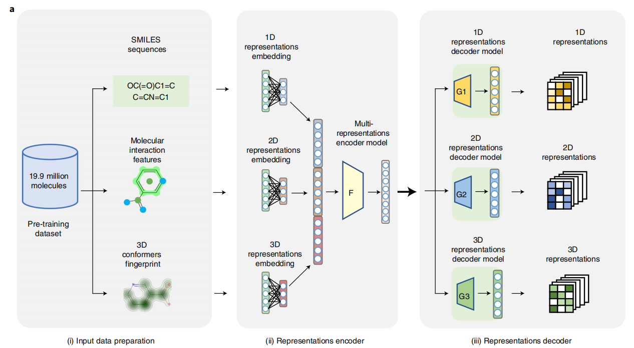
调研结果-寻找目标物质
整体路线 [1]
AI + In vitro and in vivo validation
AI 找出18个推荐 from 3724 compounds， 再用实验验证
AI part
Pretrain a Mol2Vec
on 19.9 million

Slide 9
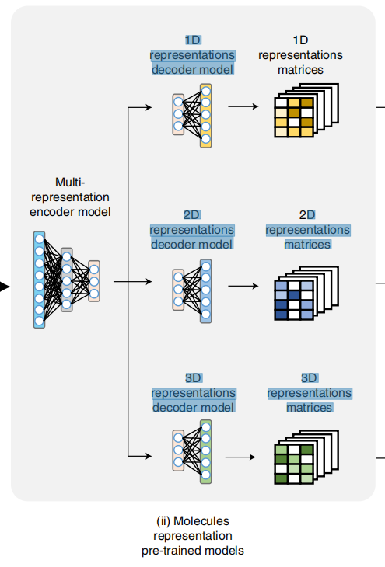
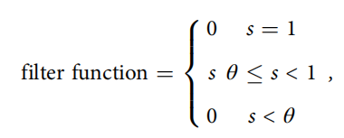
调研结果-寻找目标物质
具体技术细节 [1]
Compounds input:
from ChEMBL and ZINC database
Compounds into SMILES representations:
Using RDKit
3 Branches:
1D, 2D 3D fingerprint
Similarity computation:
dot product
Clustering:
filter

Slide 10
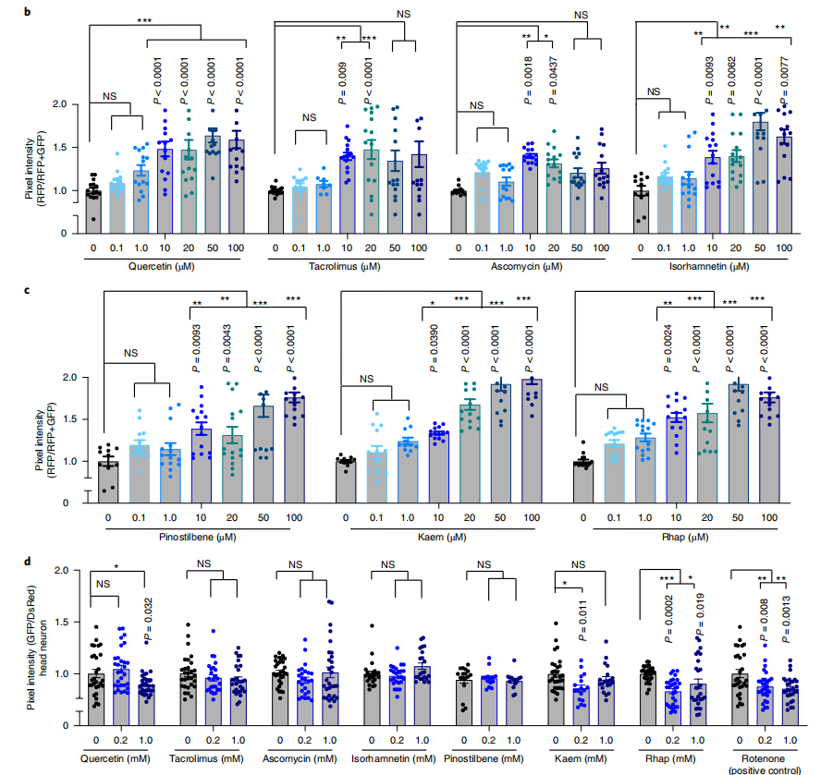
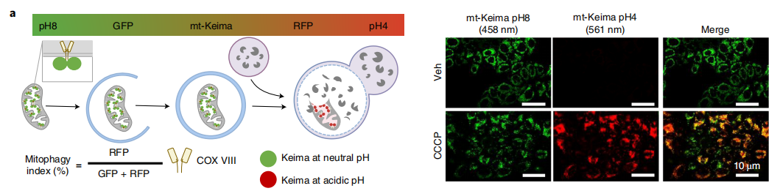
调研结果-寻找目标物质
Validation part
In vivo and vitro validation

Slide 11
调研结果-寻找目标物质
文章8 《Knowledge integration and decision support for accelerated discovery of antibiotic resistance genes》
Publish Time: 2022.4.29
Journal : Nature Communications
IF：17.694
Target：antibiotic resistance genes
To accelerate the discovery of antibiotic resistance genes (Total)
To predict the relationship between antibiotic resistance property between genes(Technically)

Slide 12
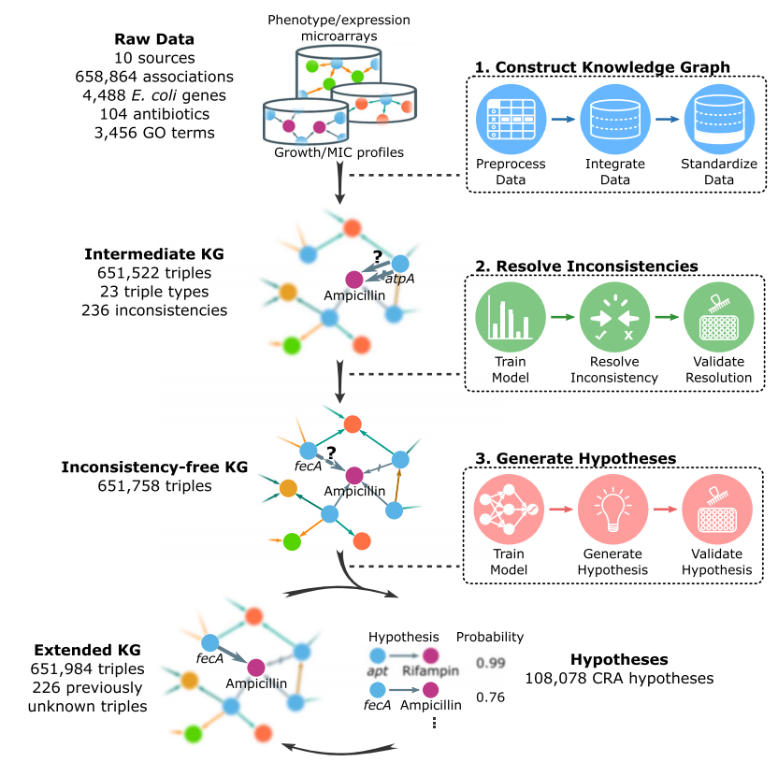
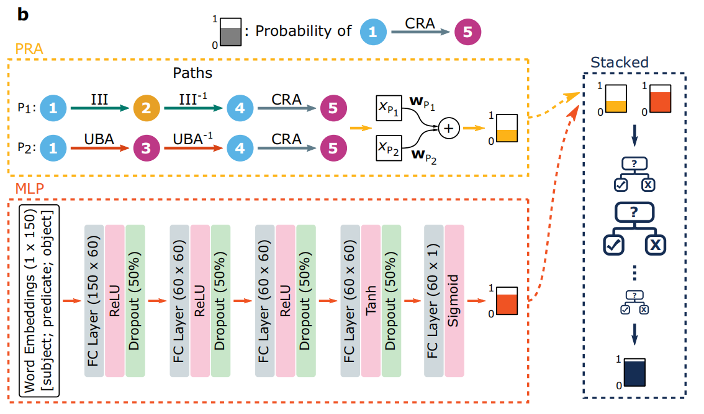
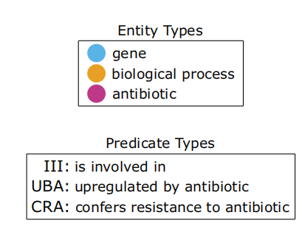
调研结果-寻找目标物质
具体技术细节 [8]
Dry-lab:
link prediction task
Deep learning model for embedding
Wet-lab

Slide 13
调研结果-类别划分
文章4 《HypoMap—a unified single-cell gene expression atlas of the murine hypothalamus》
Publish Time: 2022.10.22
Journal : Nature Metabolism
IF：19.950
Target：single-cell gene expression atlas
a unifed catalog and molecular characterization of the heterogeneous cell types

Slide 14
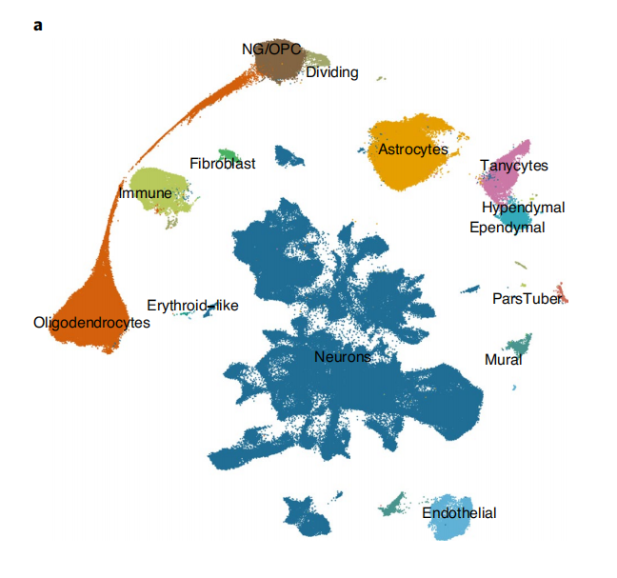
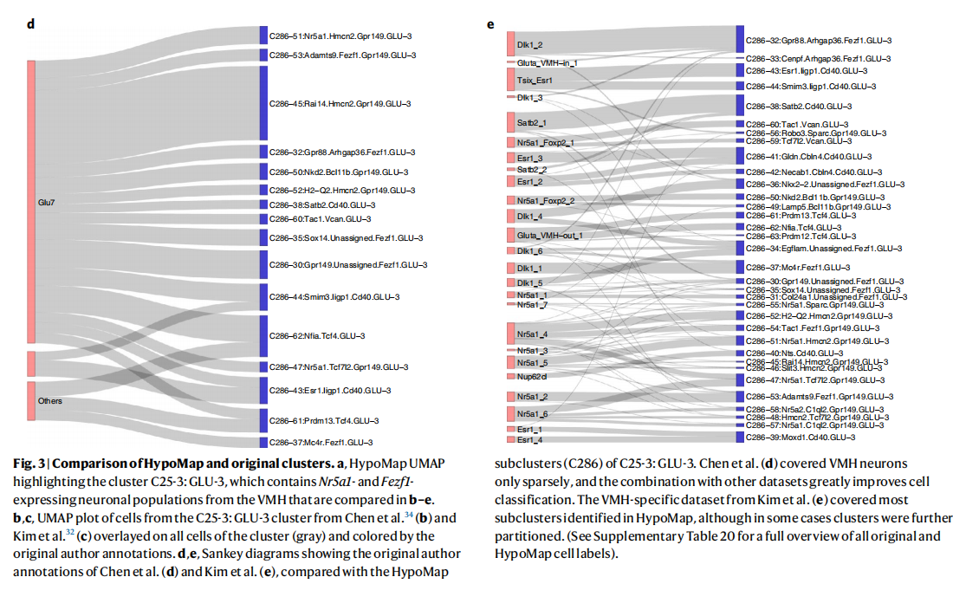
调研结果-类别划分
探索heterogeneous cell type 的划分和分类 [4]
针对问题:
neuronal subtypes in this brain region are still lacking.
呈现方式：
an integrated reference atlas

Slide 15
调研结果-探索物质的新属性
文章6 《Geometry-enhanced molecular representation learning for property prediction》
Publish Time: 2022.2.7
Journal : Nature Machine Intelligence
IF：25.898
Target：graph molecular representation
To integrate geometry information for molecular representation

Slide 16
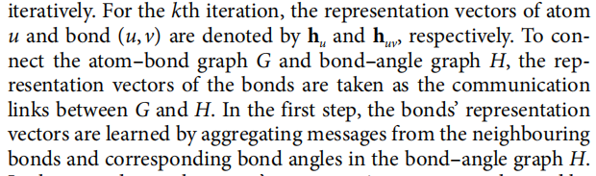
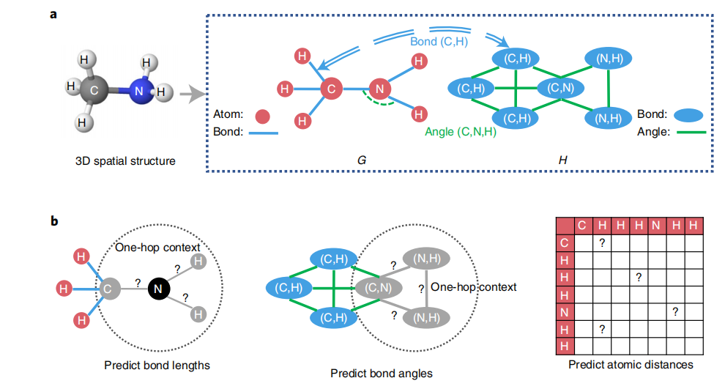
调研结果-探索物质的新属性
融入3D结构信息（融入先验信息的案例） [4]

Slide 17
调研结果-预测评估
文章7 《Predicting unseen antibodies’ neutralizability via adaptive graph neural networks》
Publish Time: 2022.11.7
Journal : Nature Machine Intelligence
IF：25.898
Target：antibodies’ neutralizability
To use GCN to predict the antibodies ’ neutralizability

Slide 18
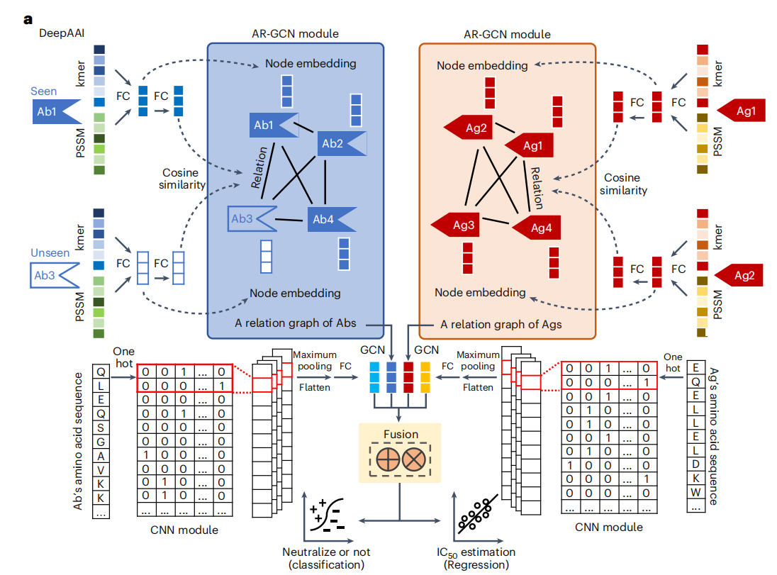
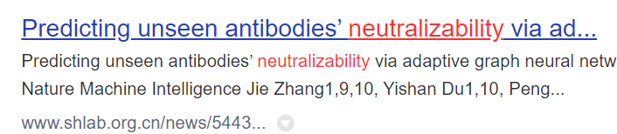
调研结果-预测评估
技术路线[7]
技术目标
learns unseen antibody representations

Slide 19
3. 任务进度更新
KG部分+泛癌部分

Slide 20
上周 KG进展
entity读取完成
双向读取都没问题
rel + entity
目前的任务，就是在探索link prediction
这个部分，类就需要自己定义
事实上，目前已经得到embedding vector，我们也可以使用其他可用于link prediction 模型

Slide 21
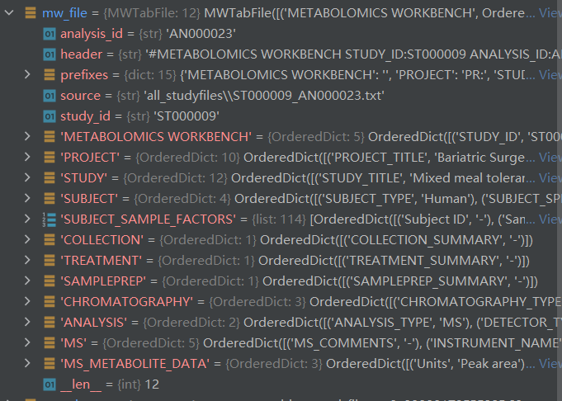
泛癌相关进展
泛癌思路
常见癌症：33种
其中做泛癌预测的，一般多的有30种以上，也有不少做19种
个人预计的，需要做一些归类和筛选
预计下一步
筛选不同的癌症
归并属性和代谢物信息
基于共有的代谢物信息，进行泛癌预测
目前在做
先对mwtab读取的title信息，进行分词
（目前想的是用jieba分词）
现在在对整体代谢物信息在处理
mwtab读取结果

Slide 22
0209 汇报
总体调研情况-调研汇报-任务进展更新

